Slide 1
Statistical Thinking for Machine Learning – Part 1

Slide 2
Statistics and Machine Learning
Statistics and Probability Theory are the foundations for modeling and machine learning
Statistical Modeling will be more concerned with inference. Understanding an effect we hope to observe
Machine Learning will be more concerned with prediction. Being able to predict an unknown value based off a sample we observed. Having a representative sample and generalizable results will be crucial.
Fit the data to desired output and learn from the data!

Slide 3
Agenda
Comprehending Data
Data in the grand scheme of things
Understanding your data frame: Rows and columns
Different types of data
Distributions
Data types and distributions
PDF and CDF
Parameters and Method of Moments
The Normal Distribution and the Central Limit Theorem
Sampling
How we can use sampling to achieve our goals
Descriptive statistics

Slide 4
Where does data fit in the big picture?
Defining a problem statement
Collecting and storing data -- Recording data, downloading data sets, web scraping or using API, data structures and lakes.
Data
Sampling and Modeling
Insights, inference, and visualization

Slide 5
Different types of Data
Binary – Taking a value of 0/1, True of False
Categorical – Taking a discrete value with limited possibilities
Continuous – A numerical variable that has a very wide range of possible values

Slide 6
Rows and Columns!
Rows are individual and separate
Independent variable
Observation | Body Weight (lbs) | Age | Height (inches) | Diet
Adam | 140 | 18 | 66 | Vegetarian
Bob | 180 | 33 | 73 | Lactose free
Charles | 220 | 46 | 76 | Vegan
Dan | 155 | 29 | 64 | Vegetarian
Dependent variable
Labels, not used in model
Independent variables can be used for unsupervised modeling
Dependent variables and independent variables can be used together for supervised modeling

Slide 7
Rows and Columns!
Rows are linked – some rows belong to the same group
Are the group means the same?
City Type | Population | Rainfall (inches)
Urban | 1.2 million | 38
Urban | 750k | 6
Suburban | 500k | 14
Suburban | 400k | 18
Rural | 320k | 32
Rural | 100k | 12
Label and categorical independent variable that will be used in model
Potential dependent variables

Slide 8
Categorical Variables and Dummy Encoding
Observation | Diet
Adam | Vegetarian
Bob | Lactose Free
Charles | Vegan
Dan | Vegetarian
Observation | Vegetarian Diet | Lactose Diet | Vegan Diet
Adam | 1 | 0 | 0
Bob | 0 | 1 | 0
Charles | 0 | 0 | 1
Dan | 1 | 0 | 0

Slide 9
Different Data Types and Distributions
A Random Variable can follow a certain distribution, depending on the data type
Bernoulli and Binomial distributions describes random variables that take binary values
A uniform distribution can handle discrete or continuous data
A normal distribution describes continuous, numeric data

Slide 10
Key Terminology of Distributions
Moments: Values from our sample that can help us understand our distribution
Parameters: The values that define our distribution
Random Variable: The entity we are drawing from or observing to form the distribution
Probability Density Function/Probability Mass Function: A description of how likely certain outcomes are in a distribution
Cumulative Distribution Function: A description of how much of a distribution is contained up to a certain point

Slide 11
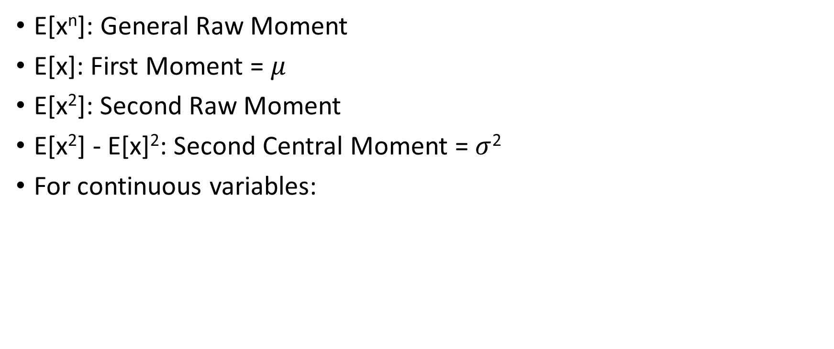
Moments of Random Variables
E[x^{n}]: General Raw Moment
E[x]: First Moment = $μ$
E[x²]: Second Raw Moment
E[x²] - E[x]²: Second Central Moment = $σ$²
For continuous variables:

Slide 12
Uniform PMF/PDF, CDF

Slide 13
Normal PDF,CDF

Slide 14
Method of Moments Calculation -- Uniform

Slide 15
Choosing a Representative Sample
Our goal when modelling is to use a sample to draw conclusions about a greater population
It’s important our sample is representative of our population. Ensuring we have a sufficient sample size is helpful for this.
Methods of repeated sampling are also good to utilize
Sample Moments = Theoretical Moments! If the sample is not representative, this equation will mislead us

Slide 16
Using Descriptive Statistics from a Sample
Measure of Central Tendency:
Mean – Arithmetic Average
Median – Middle Value
Mode – Most common value
Variance
Range, IQ range
Correlation – the foundation of the linear model!

